Slide 1
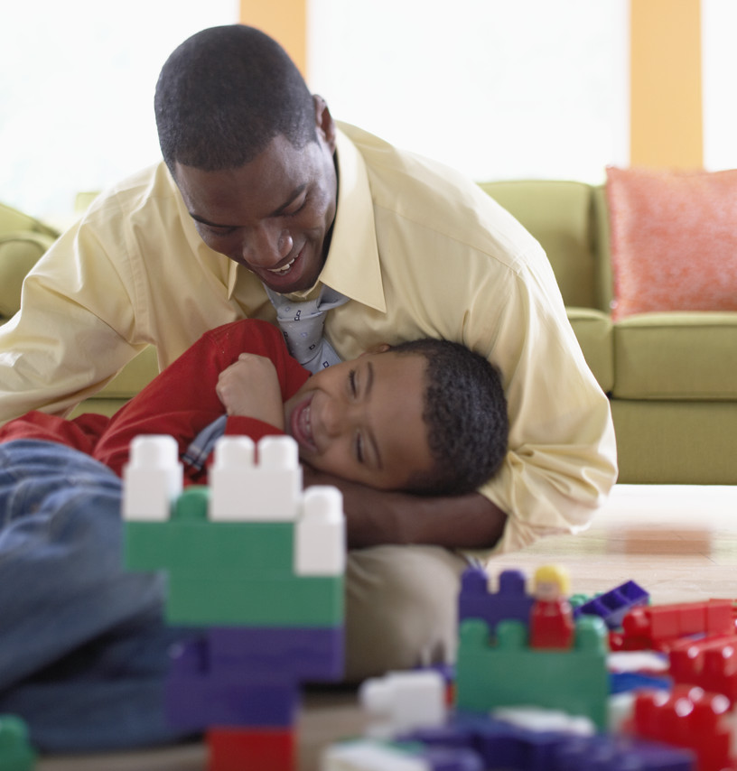
Is PCIT right for your family?
______________________
Do you have a 2 ½ to 6 year old child with challenging behaviors?
Do you worry about how to manage your child’s difficult behaviors?
If yes, then PCIT might be right for you and your family!
Contact us for more information and to schedule an appointment. We look forward to working with you!
Parent-Child Interaction Therapy (PCIT)
PRIDE Skills
Praise
Reflect
Imitate
Describe
Enjoy
Agency Name
INSERT AGENCY LOGO HERE
Street Address
City, State, Zip
Phone Number
email

Slide 2
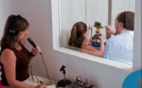
Parent-Child Interaction Therapy (PCIT)
How Does PCIT Work?
PCIT is an exceptionally effective treatment backed by over 30 years of research. Live coaching is a hallmark of PCIT. The therapist observes the caregiver and child together, then provide coaching on the PCIT skills. Caregivers and therapists work together to manage challenging child behaviors.
Advantages of Live Coaching:
Skills are acquired rapidly by caregivers, as they practice in the moment with therapist support.
Therapists provide caring support as caregivers gain confidence and master their skills.
Therapists provide immediate feedback about strategies to manage the child’s challenging behaviors.
Who is PCIT for?
PCIT is a short-term, specialized behavior management program designed for young children experiencing behavioral and/or emotional difficulties and their families. PCIT teaches caregivers to manage their child’s difficult behaviors, while increasing their positive behaviors. PCIT works with the child and caregiver together to improve behavior and reduce parenting stress.
Children ages 2 ½ to 6 who display any or all of the following:
Parent-child relational problems
Refusal and defiance of adult requests
Easy loss of temper
Purposeful annoyance of others
Destruction of property
Difficulty staying seated
Difficulty playing quietly
Difficulty taking turns
What is PCIT?
PCIT consists of weekly sessions conducted in two treatment phases.
Who are appropriate caregivers for PCIT?
Child-Directed Interaction (CDI)
Caregivers are taught the PRIDE skills: Praise, Reflect, Imitate, Describe and Enjoyment. These skills promote positive child behaviors.
Biological parents
Foster parents
Adoptive parents
Legal guardian
Grandparents
Kinship caregivers
Parent-Directed Interaction (PDI)
Caregivers learn to use effective commands and discipline procedures. The PCIT therapist helps caregivers manage their child’s behaviors in many settings.

